Slide 1
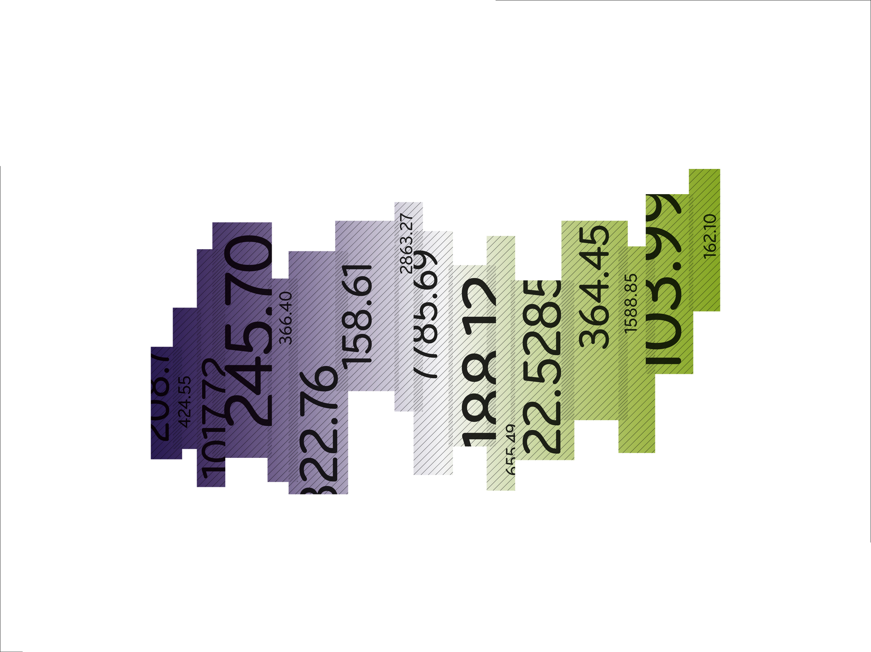

STOXX® Optimised South Africa
01.04.2011

Slide 2
Agenda
Index Concept Page 3
Index Methodology Page 8
Available Indices, Contacts Page 14

Slide 3
1. Index Concept

Slide 4
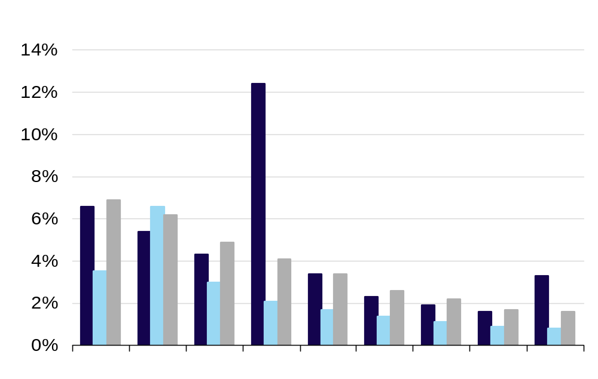
The optimized weighting prevents large weights of illiquid constituents
Overview: Index concept
Index Weights
  Large discrepancies between market capitalization an liquidity may occur
  In such cases market cap weighting leads to high weights of illiquid assets
  The optimized concept down scales constituents weights (if its liquidity value is below the weighted index average)
12.4%
Large discrepancy between Market cap and Liquidity
4.1%
2.1%
Market Cap
Liquidity
Optimized

Slide 5
Index weights are based on market capitalization as well as liquidity
Index methodology
Basic Concept
Index Methodology
Selection
  Constituents need to have a market cap of min. 180m USD and ADTV (3-month) of min. 1.2m USD
  Constituents whose market cap falls below 120m USD or ADTV (3-month) drops to 0.8m USD on the target date¹⁾ will be excluded from the index
  Weighting
  Constituents are weighted according to the STOXX Optimized index weighting methodology based on a full-market cap at target date and 3 months ADTV prior to (and including) target date¹⁾
  Capping Mechanism
  In order to ensure a maximum weight of 10% per component a special capping mechanism is applied
  Index Universe: Components listed on Johannesburg SE, respectively
  Review: yearly
  Rebalancing: quarterly
  # Constituents: 30
¹⁾ 8 calendar days prior to the review date in September

Slide 6
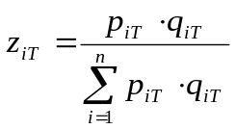


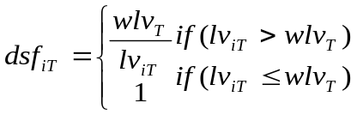


Advanced capping / weighting mechanism leads to superior tradability
Index methodology
The advanced capping-mechanism
  1st step: determination of full-MC-weights:
  2nd step: calculation of liquidity value:
  3rd step: calculation of sum of weighted liquidity values:
  4th step: calculation of downscaling factor:
  5th step: calculation of adjusted-MC:
  6th step: calculation of adjusted-MC: The capping at 10% will be conducted based on

Slide 7
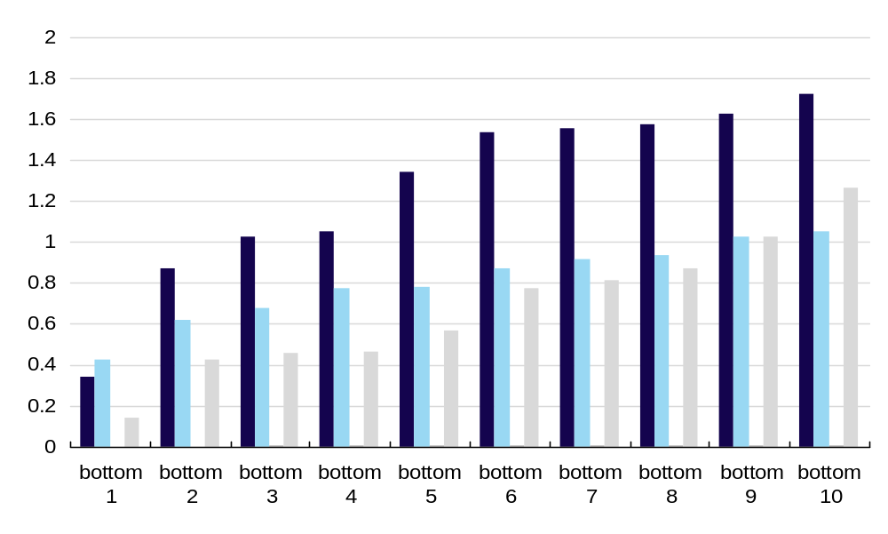
The index concept significantly improves liquidity of bottom 10 constituents in South Africa
Comparison to regional indices
STOXX Optimised South Africa
STOXX Optimised South Africa
FTSE/JSE AFRICA TOP40
FTSE/JSE AFRICA ALL SHARE
FTSE/JSE AFRICA IND25
¹⁾ ADTV (3-month) in USD m.
Sources: STOXX; Bloomberg

Slide 8
2. Performance Key Figures

Slide 9
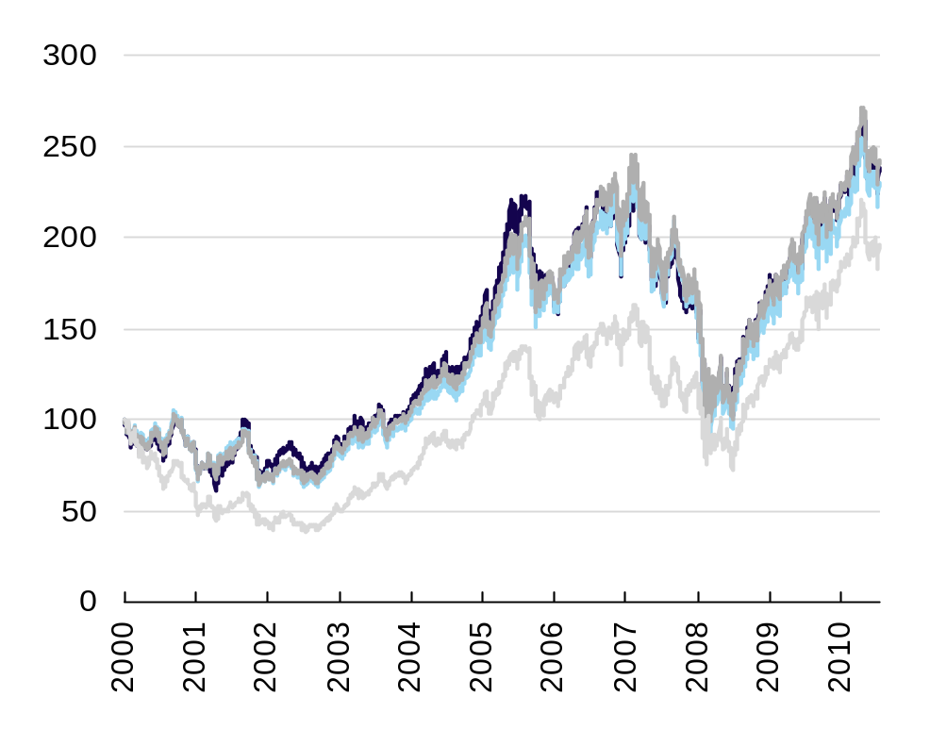
Optimized weighting concept and definition of minimum ADVT per stock assured tradability of index
STOXX Optimised South Africa
Overview
Performance EUR
Concept
  Optimized weighting concept based on specialized capping mechanism
  Quarterly rebalancing
  Annual re-composition (September)
  ADTV (3-months) > 1.2mn USD
  Market cap > 180m USD
  Key Figures¹⁾
Index | Performance | Volatility
STOXX Optimised South Africa | 8.49% | 28.52%
FTSE/JSE AFRICA TOP40 IX | 8.11% | 28.62%
FTSE/JSE AFRICA ALL | 8.67% | 27.22%
FTSE/JSE AFRICA IND25 IX | 6.50% | 26.70%
STOXX Optimised SA
FTSE/JSE AFRICA TOP40 IX
FTSE/JSE AFRICA ALL
FTSE/JSE AFRICA IND25 IX
Figures for 15.09.2000 - 28.03.2011
Sources: STOXX; Bloomberg

Slide 10
3. Available Indices, Contacts

Slide 11
STOXX Optimized indices are calculated in six versions per Country
Available indices
Index | Type | ISIN | Bloomberg | Calculation Frequency
STOXX Optimised South Africa | Price EUR | CH0119596135 | AFOSAP Index | Real Time
STOXX Optimised South Africa | Net Return EUR | CH0119596077 | AFOSAT Index | End of Day
STOXX Optimised South Africa | Gross Return EUR | CH0119596101 | AFOSAGT Index | End of Day
STOXX Optimised South Africa | Price USD | CH0119596143 | AFOSAK Index | Real Time
STOXX Optimised South Africa | Net Return USD | CH0119596085 | AFOSAU Index | End of Day
STOXX Optimised South Africa | Gross Return USD | CH0119596119 | AFOSAGU Index | End of Day

Slide 12
STOXX sales contacts
Americas
Europe
Asia
ETFs, Structured products
Rosanna Grimaldi
Head of Sales Europe, Asia, LatAm, Middle East
+41 (0)79 470 3575 (mobile)
rosanna.grimaldi@stoxx.com
Rod Jones
Head of Sales North America
+1 917 916 6027 (mobile)
rod.jones@stoxx.com
Asset Managers, Investors
Lucas van Berkestijn
Head of Buy-Side Europe, Asia, LatAm, Middle East
+41 (0)79 359 9454(mobile)
lucasjan.vanberkestijn@stoxx.com

Slide 13
Disclaimer
The indices in the presentation and the trademarks used in the index names are the intellectual property of STOXX Ltd, or SIX Swiss Exchange AG, or Deutsche Börse AG.
The use of the STOXX®, DAX®, and SMI indices® and of the respective index data for financial products or for other purposes requires a license from STOXX, Deutsche Börse AG, or SIX Swiss Exchange AG. STOXX and its owners do not make any warranties or representations, express or implied, with respect to the timeliness, sequence, accuracy, completeness, currentness, merchant- ability, quality, or fitness for any particular purpose of its index data. STOXX and its owners are not providing investment advice through the publication of indices or in connection therewith. In particular, the inclusion of a company in an index, its weighting, or the exclusion of a company from an index, does not in any way reflect an opinion of STOXX or its owners on the merits of that company. Financial instruments based on the STOXX®, DAX®, or SMI indices® are in no way sponsored, endorsed, sold, or promoted by STOXX or its owners.
About STOXX
STOXX Ltd. is an established and leading index specialist of European origins. The launch of the first STOXX® indices in 1998, including the EURO STOXX 50® Index, marked the beginning of a unique success story, based on the company’s neutrality and independence. Since then, STOXX has been
at the forefront of market developments, continuously expanding its portfolio of innovative indices –
and now operating on a global level, across all asset classes.
The indices are licensed to more than 400 companies among the world’s largest financial products issuers, capital owners, and asset managers. They are used not only as underlyings for financial products such as ETFs, futures and options, and structured products, but also for risk and performance measurement. In addition, STOXX Ltd. is the marketing agent for the indices of Deutsche Börse AG and SIX Swiss Exchange Indices, among them the DAX® and the SMI indices®.

